Slide 1

Product Technical Training
Module 1. Product Overview

Slide 2
SERVICES FROM
DIFFERENT SUPPLIERS
HOTELS / ACCOMODATION
HOTEL MARRIOTT
TAJ HOTELS
HOLIDAY VILLA
PASSENGER
PASSENGER
CAR-HIRE
JOE CAR RENTALS
OLA CABS
PASSENGER
TOUR
OPERATOR
TRANSFERS
SAM – CAR TRANSFERS
TR – CAR TRANSFERS
FLIGHTS
EMIRATES
`JET AIRWAYS
AGENT 1
PASSENGER
PASSENGER
AGENT 2
EXCURSION
HALF DAY CITY TOUR
DOLPHIN TRIP
PASSENGER
Notes:
Tour Operator - Is a Travel company that sells travel related products to travelers or other agents
Supplier - The Tour Operator does not own any service like a hotel, flight etc. They buy it from Suppliers.
Service - A supplier can have one or many services
Options
Extras and
Facilities

Slide 3
PASSENGER
PASSENGER
ENDPOINTS
AGENT
WEBSITE
AGENT
SUPPLIER 1
B2B
WEBSERVICE
TSv2
API
TSv2
WEBSITE
SUPPLIER
EXTRANET
WEBSITE
SUPPLIER 2
TS
TRAVEL
STUDIO
Supplier Extranet Webservice
Channel Manager Companies
CHANNEL
MANAGER
WEBSERVICE
B2C
WEBSERVICE
FSDT Webservice
FS
TOUR OPERATOR
SUPPLIER 3
FS
DNN WEBSITE
SUPPLIER 4
TOUR OPERATOR WEBSITE
PASSENGER
PASSENGER
SUPPLIER
PASSENGER
PASSENGER
PASSENGER
Notes:
ODL Application

Slide 4
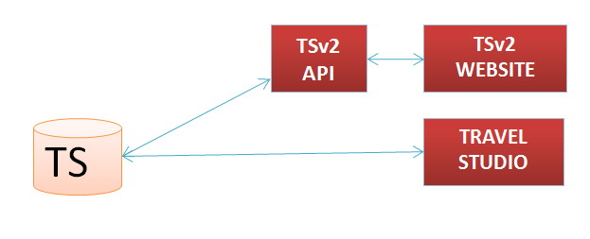
Travel Studio and TSv2
TS is Windows based Application
TSv2 is Web based version of TS
Product used by medium to large Tour Operators
Used by the employees of the Tour Operator
Notes:
An industry-leading, end-to-end Reservations system for medium to large Tour Operators.
Allows complete functionality related to setting up data and performing booking and related tasks.
It allows to create services, packages, flights etc. and then allows to search, book or amend the bookings.

Slide 5
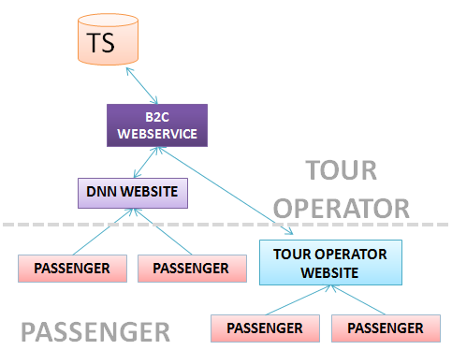
B2C API and DNN Website
B2C API
Web Service that allows booking and related functionality on Tour Operator’s Website
Only verified and Internet Available prices are returned from API
DNN Website
Web Content Management Software.
DNN can be customized by creating Modules. ODL has developed the booking flow using the dotnetnuke framework.
The DNN modules internally use the B2C API.
Notes:
Tour operators can develop their own website and integrate the B2C API to provide Booking functionality
Can be used for passenger booking as well as Agent Booking.
Allows to
Search, Book, Amend, Cancel & other functions
For Services, Packages, Car-hire, Transfers etc.
Does not allow setup data like creating service etc.
Only verified and Internet Available prices are returned from API
DNN – Helps to create WS without much technical knowledge
The Tour operator needs to buy the DNN s/w and a database.
The default functionality of DNN can be expanded by 3rd party modules
ODL has developed the booking flow using the dotnetnuke framework.
This provides the tour operator a ready booking flow which he only has to configure on his DNN website.
The DNN modules internally use the B2C API to provide the functionality. - Refer to the document on DNN

Slide 6
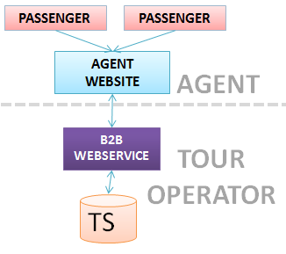
B2B API
B2B API is a Web service
Used by Agents of the Tour operator on their Website
Prices returned as per pricing policy of Agent
Notes:
B2B(30 methods) is a wrapper to B2C(300 methods) Web service
Agents don’t get to see pax information in TS.

Slide 7
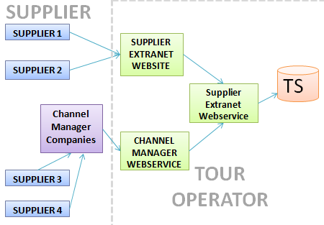
Supplier Extranet & Channel Manager API
Supplier Extranet
Website Developed by ODL
The Tour Operator provides this to Supplier to update Supplier related information
Price, Allocation, Rules
Channel Manager API
Web Service
Integrated by Third Party Channel Manager Companies
Send updates for buy prices, allocations etc
Notes:
Channel manager API is a webservice API which does not have a UI.
The API is integrated by their party channel manager companies on behalf of the supplier to send updates for buy prices, allocations etc.
Suppliers are never shown Sell related information.

Slide 8
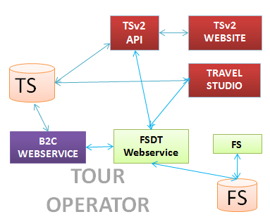
Fare Studio and FSDT Web Service
FSDT Web Service - connects Travel Studio with Fare Studio and to the external sources such as the GDS and Direct Airline Connections
Fare Studio is the management tool which handles flight contracts
Travel Studio is the management tool which handles the reservation aspect of a flight and subsequent documentation

Slide 9

Global Distribution System(GDS)
(GDS) is a network operated by a company that enables automated transactions between travel service providers (mainly airlines, hotels and car rental companies) and travel agencies.
Airline-1 CRS
Airline-2 CRS
Airline-3 CRS
Airline-4 CRS
Airline-5 CRS
GDS 1
GDS 2
GDS 3
Travel Agency
Travel Agency
Travel Agency
Travel Agency
Travel Agency
Travel Agency
Travel Agency
Travel Agency
Travel Agency
Travel Agency
Travel Agency
Travel Agency
Notes:
FSDT web service is the key component which connects Travel Studio with Fare Studio and to the external sources such as the GDS and Direct Airline Connections
A GDS primarily provides the booking functionality of flights on airlines which the GDS has agreements with. Some airlines may completely be hosted in the GDS whereas others simply provide access to their inventory via an API.
once a client uses Travel Studio, they will be requested to obtain web service credentials in order to perform flight searches from within Travel Studio
It’s simply a matter of being able to source multiple services via one system
A PNR (Passenger Name Record) is a unique alpha numeric reference of a passenger in the GDS (like a booking record). The PNR will contain the following details which we use to map back into Travel Studio using web services

Slide 10
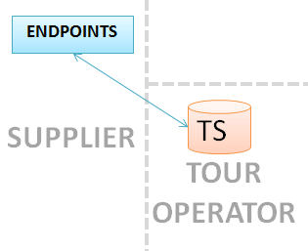
Endpoints
Some companies aggregate the services of different supplier and sell it using an API.
These third-party API’s are called endpoint which is integrated into the TS application to sell services via TS
Steps to configure Endpoints
Endpoint Configuration
Endpoint Mapping
Endpoint Service Import
Notes:
Contain services not part of TS.
No guarantee of availability
No allocations given
Endpoint Configuration
Specify Endpoint URL, Endpoint login details and other settings.
These vary from endpoint to endpoint
2. Endpoint Mapping
Map TS data with endpoint data
3. Endpoint Service Import
Endpoints provide either a Remote URL or a CSV/TXT File to be saved on Local Travel Studio installed machine.
These contain details of the services contracted by the Tour Operator
Except for the Price and the availability of these services these are subject to change so they are obtained in Travel Studio in real time at the time of search or book.

Slide 11
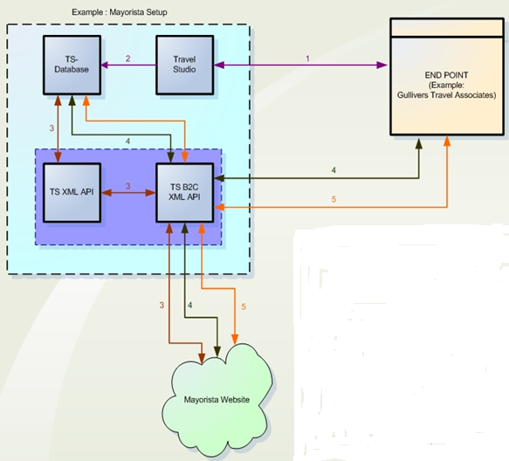
How Endpoints Work
TS request Endpoint for services; accordingly the endpoint return the result.
TS updates the TS database with the details.
When visitor searches for services, all services including the imported ones are listed.
B2C API connects to the endpoint to get availability and pricing.
Incase of booking; B2C API first updates the TS Database and then sends a booking request to the endpoint Database.
Notes:
TS makes a request to an endpoint for services based on Service Type, Service Name and City. Accordingly the endpoint returns the result to TS
TS then updates the TS database with the details received (options, facilities, address and images). These details are editable via the service maintenance option in TS. The imported services will have buying and selling price as 0; therefore if any booking is done via TS the estimated rates will have to be used.
When any visitor makes a search for any services on the client website, all the relevant services (including the ones imported via the endpoint would be listed on the website. This is done via the TS B2C XML web service component. TS XML API is used for search requests.
When any visitor wants to check for the availability and pricing of an imported services on the website from the displayed result, then the TS B2C XML web service connects to the concerned end-point to get the service price and computes the new selling price by applying the necessary formula stored in the TS database.
If the visitor goes ahead and books the services, the TS B2C XML web service component updates the endpoint database as well as the TS database.

